Slide 1

MIDTERM PRESENTATION
Introduction to Information Security
521K0025 - Trinh Hung Quan
521K0143 - Duong Ngoc Bao Nhi
Class: 21K50201 - 21K50301
Group: 1
Instructor: Huynh Ngoc Tu

Slide 2
CONTENTS
Overview
What is Iris recognition?
History of Iris recognition
What is Iris?
How does it work? (Operating Principle)
Solution technique for Iris recognition
Advantages of Iris recognition
Challenges of Iris recognition
Application of Iris recognition
Contexts and security scenarios

Slide 3
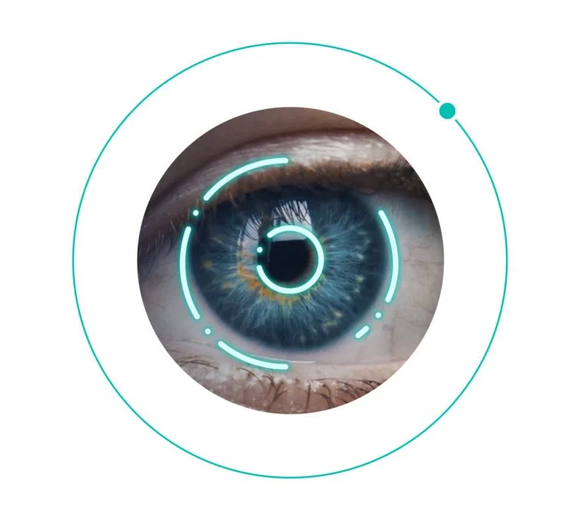
OVERVIEW
1. What is Iris recognition?
Iris recognition is a biometric authentication technology that uses the unique patterns of the iris (the colored ring around the pupil of the eye) to identify individuals. It is considered one of the most reliable and accurate methods with very low false match rates for personal identification due to the highly distinctive and stable nature of iris patterns.

Slide 4

OVERVIEW
2. History of Iris recognition:
The concept of Iris Recognition was first proposed by Dr. Frank Burch in 1939.
It was first implemented by Dr. John Daugman in the 1990s.
These algorithms employ methods of pattern recognition and some mathematical calculations for iris recognition.

Slide 5
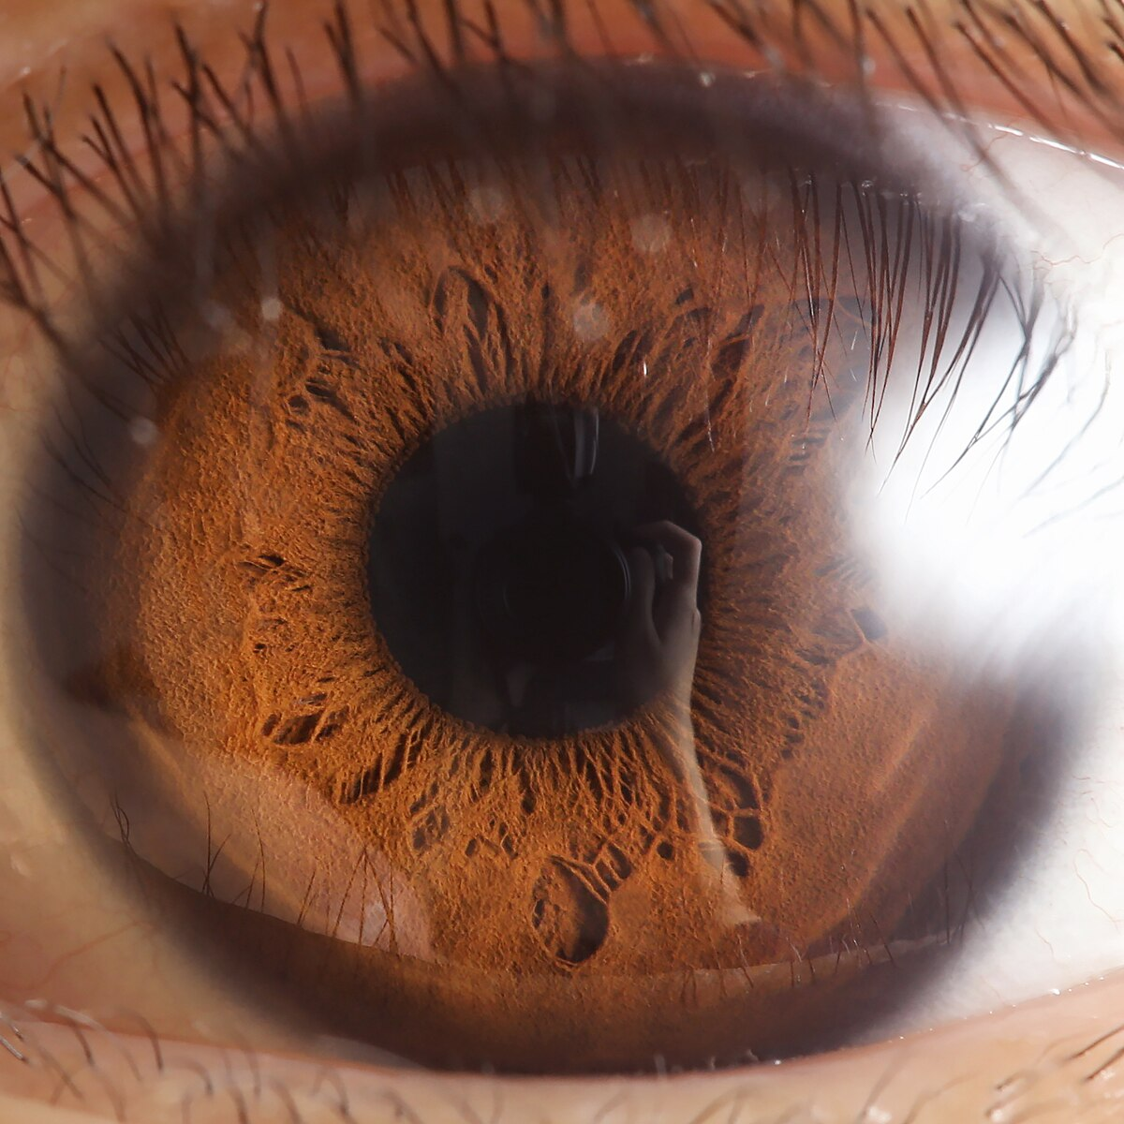
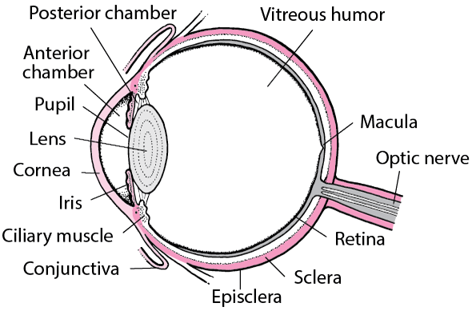
OVERVIEW
3. What is Iris?
The iris is the colored part of the eye.
It's a thin, circular structure located behind the cornea and in front of the lens.
Common colors include brown, blue, green, and gray.
The unique pattern of the iris forms during embryonic development and remains stable throughout a person's life.

Slide 6
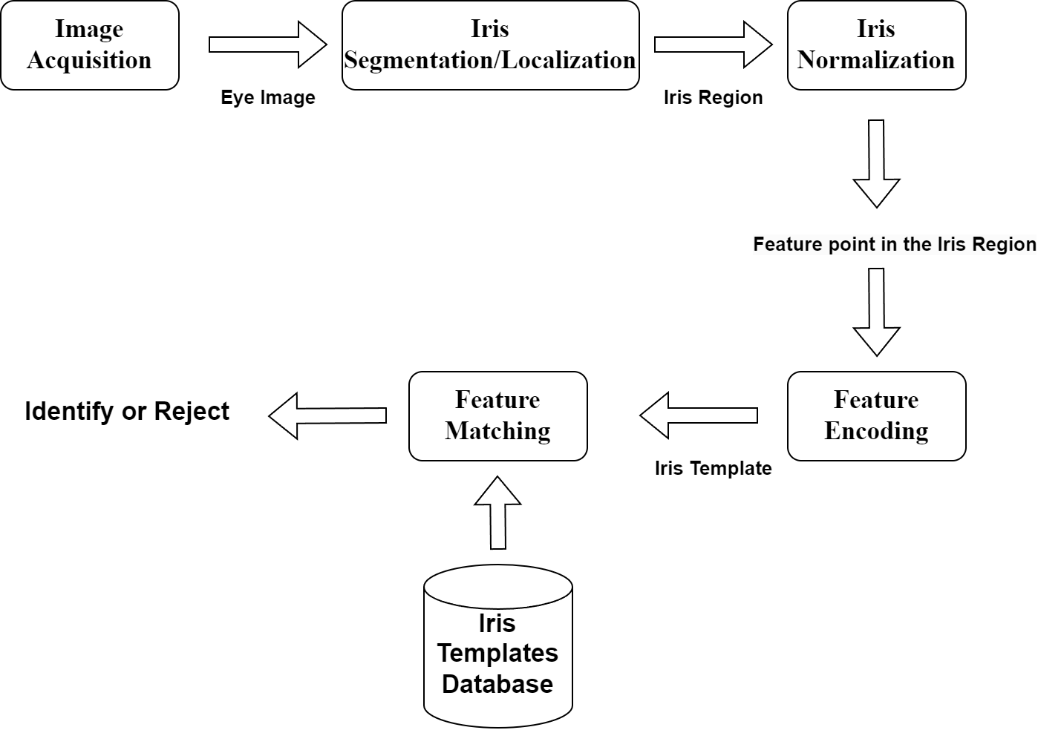
OVERVIEW
4. How does it work? (Operating Principle)

Slide 7
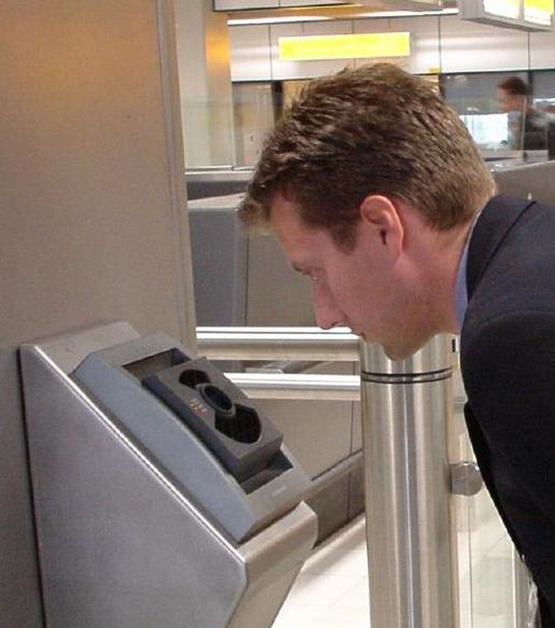
OVERVIEW
4. How does it work? (Operating Principle)
Image Acquisition:
The process begins with capturing a high-resolution image of the subject's eye using a specialized iris camera or a camera with infrared illumination.
The captured image should contain the entire eye, including the iris, pupil, and surrounding areas.

Slide 8
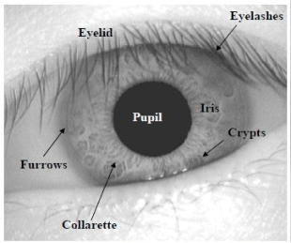
OVERVIEW
4. How does it work? (Operating Principle)
Iris Segmentation/Localization:
Iris segmentation, also referred to as iris localization, involves identifying and isolating the iris region within the captured eye image.
The segmented iris region is separated from other structures such as the pupil, sclera (white part of the eye), eyelids, and eyelashes.

Slide 9
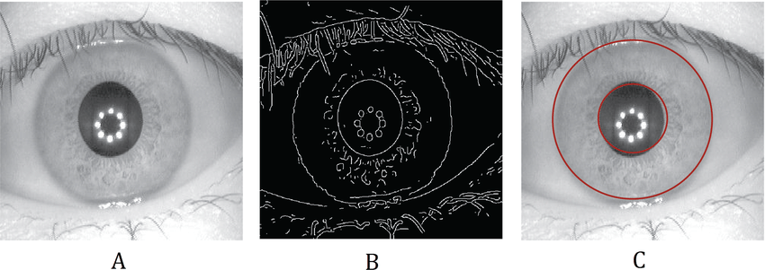
OVERVIEW
4. How does it work? (Operating Principle)
Iris Segmentation/Localization:
Techniques such as circular Hough transform, edge detection, or machine learning-based methods are employed to detect the circular boundary of the iris.

Slide 10
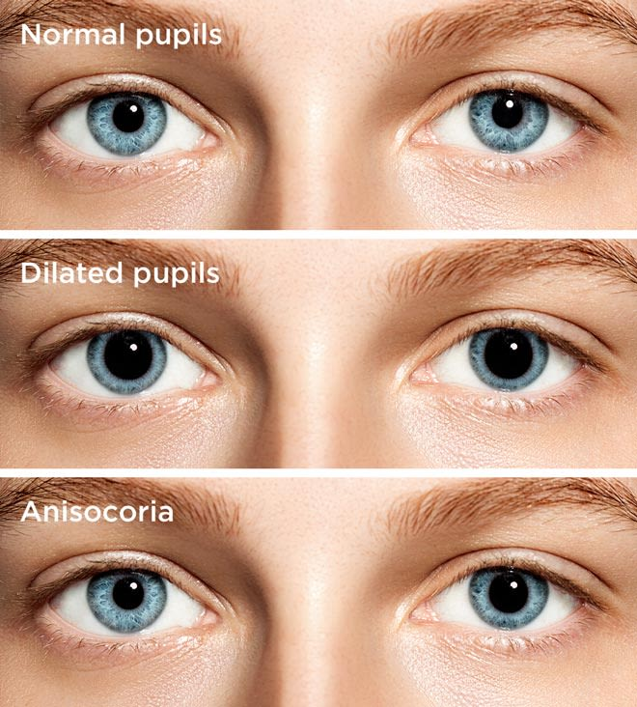
OVERVIEW
4. How does it work? (Operating Principle)
Iris Normalization:
Iris normalization is performed to standardize the size, rotation, and illumination of the segmented iris region, ensuring consistency for feature extraction and comparison.
The segmented iris region is transformed into a standardized format, often a rectangular or polar representation, compensating for variations in pupil size, eye rotation, and camera perspective.

Slide 11
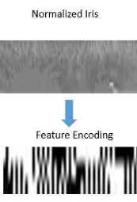
OVERVIEW
4. How does it work? (Operating Principle)
Feature Encoding:
Feature encoding involves extracting distinctive features from the normalized iris image and encoding them into a compact and standardized representation.
These features are then encoded into a mathematical representation, which captures the unique characteristics of the iris while reducing storage requirements.

Slide 12
OVERVIEW
4. How does it work? (Operating Principle)
Feature Matching:
Feature matching is the final step where the encoded iris template obtained from the enrolled image is compared with templates stored in the database for authentication.
Matching algorithms such as Hamming distance, Euclidean distance, or machine learning-based classifiers.
If the similarity score exceeds a predefined threshold, the subject is authenticated, indicating a match between the captured iris and the enrolled template.

Slide 13
OVERVIEW
5. Solution technique for Iris recognition:
Edge Detection: Algorithms detect the boundaries of the iris and pupil.
Gabor Filters: Specialized filters are used to extract and encode the unique texture patterns of the iris.
Hamming Distance: A mathematical method is used to compare and match iris codes.
Normalization: Iris images often undergo normalization processes to account for variations in size, rotation, and illumination.
Segmentation: Segmentation techniques are used to isolate the iris region from the rest of the eye image.

Slide 14
OVERVIEW
6. Advantages of Iris recognition:
High Accuracy: High accuracy and reliability due to the unique and stable nature of iris patterns.
Non-intrusive: Non-invasive and contactless, making it hygienic and user-friendly.
Spoof and forge: Difficult to spoof or forge, providing enhanced security.
Long-term stability of iris patterns, enabling long-term identification: The iris, protected by the cornea, is internally shielded from damage. Unlike fingerprints prone to wear, iris shape remains stable over time. Controlled by only two muscles, its predictable geometry enhances recognition accuracy.

Slide 15
OVERVIEW
7. Challenges of Iris recognition:
Cost: Requirements for specialized hardware and image acquisition systems.
Privacy Concerns: Some individuals may have concerns about the collection and storage of biometric data, including iris images.
Environmental Factors: External factors such as lighting conditions and occlusions (eyeglasses, contact lenses) can affect the quality of iris images, impacting recognition accuracy.
Other impacts: Potential for false matches or non-matches due to factors like aging, injuries, or alcohol consumption (causes deformation in Iris pattern).

Slide 16


II. APPLICATION OF IRIS RECOGNITION
Iris recognition technology is used in various applications, including:
Access control systems for secure facilities or buildings.
Border control and immigration systems.
Law enforcement and criminal identification.
Identity verification for financial transactions or secure document issuance.
User authentication in computer systems or mobile devices.

Slide 17
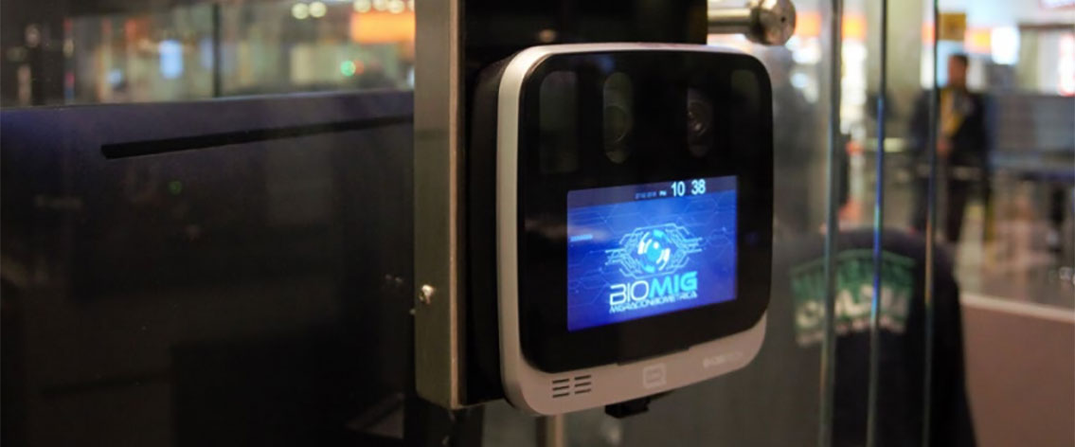
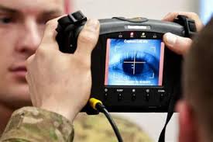
III. CONTEXTS AND SECURITY SCENARIOS
Iris recognition is commonly employed in high-security environments where reliable and accurate identification is critical. Some scenarios include:
Government agencies and military installations.
Airport and border control checkpoints.
Banking and financial institutions.

Slide 18
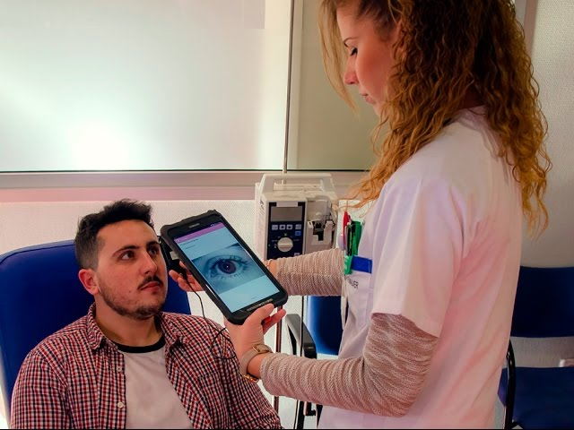
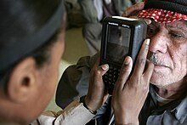
III. CONTEXTS AND SECURITY SCENARIOS (CONT)
Healthcare facilities for patient identification and medical record access.
Secure access to data centers or critical infrastructure.
Forensic investigations and criminal identification systems.
In these contexts, iris recognition offers a highly secure and reliable means of verifying identities, enhancing security, and preventing unauthorized access or identity fraud.

Slide 19
REFERENCE MATERIALS
https://www.nec.com/en/global/solutions/biometrics/iris/index.html
https://www.innovatrics.com/iris-recognition-technology/
https://en.wikipedia.org/wiki/Iris_recognition
https://link.springer.com/referenceworkentry/10.1007/978-0-387-73003-5_252
https://www.hindawi.com/journals/complexity/2021/6641247/
https://www.cl.cam.ac.uk/~jgd1000/irisrecog.pdf

